Slide 1
HND Networking: Multi User Operating Systems (DH3A 34)
Lecturer – Dawn Wilson

Slide 2
MUOS: Overview
1 core credit
Outcome 1(1 hour, closed book, 60% pass mark):
20 multiple choice questions covering:
Features of a multi user operating system
Types of multi user operating systems
Hardware and software components of a multi user operating system
Outcome 2 (open book, practical assessment)
Use the facilities of a multi user operating system to demonstrate knowledge of a minimum of 7 skills
Outcome 3 (open book, practical assessment)
Compose scripts to carry out routine tasks demonstrating knowledge of passing arguments, using editor(s), using environment variables, selecting and using control structure(s)

Slide 3
What is an Operating System (OS)?
Control Program
An operating system is a set of (often-unrelated) software programs, which manage computer hardware in a controlled fashion.
The OS tells the hardware how to work and provides protocols and mechanisms for sharing information and data
&
Resource Manager
An operating system controls the file-system, process management, memory management, and peripherals. It is the job of the operating system to act as a resource manager for these components and provide an interface for the user to use these facilities.
The operating system allocates resources to programs and users as required based on a policy that attempts to ensure fairness and efficiency and deal with conflicts as they arise

Slide 4
Key objectives of an OS
2 key objectives of an operating system:
make the underlying hardware convenient to use
The OS is a layer of software which sits on top of the hardware to abstract the complexity and detail of the hardware from the application programmers and presents users with an interface which is easier to understand.
make efficient use of the available hardware
computer systems consist of one or more processors, some main memory, input/output devices, visual display units, disks, network interfaces, modems etc. The components must be capable of communicating with each other without confusion or error. Resources have to be shared amongst users and their applications therefore this has to be done in a fair and efficient manner.

Slide 5
Types of OS
Operating systems function in one of 4 ways:
Batch
Interactive/Time sharing
Real Time
Distributed

Slide 6
Types of OS - Batch
Jobs with similar needs are batched together and run one after another
A 'batch' is the name given to the task of doing the same job over and over again, the only difference being the input data presented for each iteration of the job and perhaps the output
Unsuitable for interactive users as they cannot interact with job whilst it is running
Used when high utilisation of hardware required
Objective is to maximise processor use
e.g. MSDOS – batch processing of employee payslips

Slide 7
Types of OS – Interactive/Time-sharing
An interactive OS is one that allows the user to directly interact with the operating system whilst one or more programs are running.
The user can interact with jobs and will receive the results of processing immediately. The user is in direct two way communication with the computer.
Objective is to minimise response time
e.g. Linux, Windows

Slide 8
Types of OS – Real-Time
OS will give guaranteed feedback within a predefined set period of time
Used in mission critical systems as removes unpredictability
Rigid time constraints are placed on processors and the flow of data
e.g. VxWorks - aerospace and defence
Hard real-time
guarantees critical tasks within specified limits
Soft real-time
attempts to do its best to meet deadlines but ensures that critical tasks get priority

Slide 9
Types of OS - Distributed
software over a collection of independent, networked, communicating and physically separate computational nodes.
A layer of software is added to the operating system of a computer connected to the network. This layer intercepts commands that reference resources elsewhere on the network providing users with access to various resources at a number of remote sites
e.g. a file server, then redirects the request to the remote resource in a manner completely transparent to the user.
A single task can be split into smaller tasks each run on a separate computer. The distributed OS co-ordinates all the activity and gathers results.
e.g. Plan 9, Inferno, Ameoba. Used for CGI render farms.
“Clean Energy Project” – makes use of idle processing capacity of internet connected PC’s

Slide 10
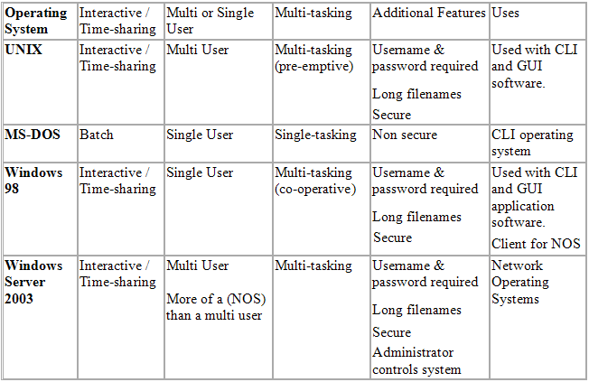
Real world OS examples

Slide 11

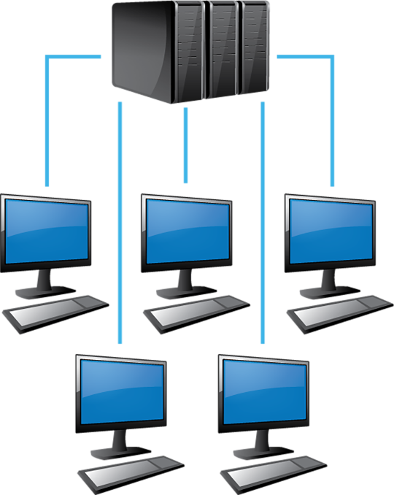
OS user environments
Operating systems can support two different user environments:
Single user
Multiple concurrent users

Slide 12
Single User OS
As a Windows PC user, you will be most familiar with the single user operating system.
Single user means the OS provides support for one user at a time to use its facilities. It can be split into two types:
single user, single application (single tasking) operating systems
operating system only has to deal with one person at a time, running one user application at a time e.g. MS-DOS
single user, multi tasking operating systems
operating system is designed mainly with a single user in mind, but it can deal with many applications running at the same time e.g. Windows

Slide 13
Multi user OS
there comes a time when only a really powerful computer will do the job in hand
e.g. you are an engineer or scientist and want to run a very complicated simulation, you are a financial person and want to work on thousands of stock market share movements
a mainframe or supercomputer is required for this kind of work, but they costs millions to buy and maintain
too expensive to be used by just a single person, has to be shared!
Need more than one user logged on using the computer at the same time (multi-user). Furthermore, each person needs to be able to run more than one application at a time, so it needs to be multi-tasking as well.
So a powerful computer needs a multi-user, multi-tasking operating system to make maximum use of the machine. Each person can draw on the vast power of the computer in a shared way.

Slide 14
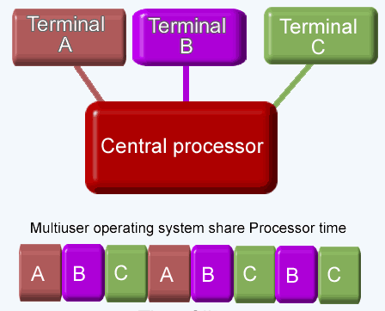
Multi user OS
Multi user means that the OS must provide support to more than one user simultaneously
Must support all of the features of a single OS and allow multiple users access to multiple applications

Slide 15
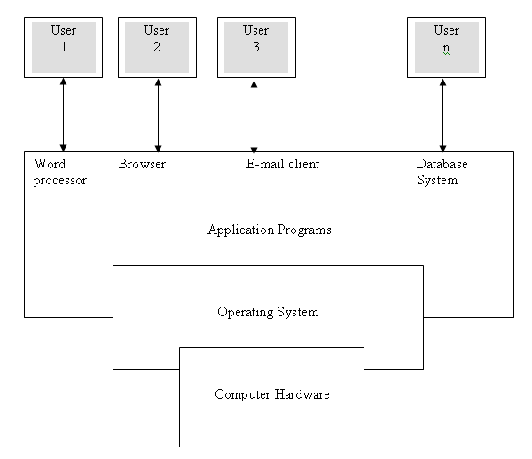
Multi User OS Architecture

Slide 16
Activity
MOODLE quiz
Week 1 – Overview of an operating system

Slide 17
Multi user OS
The remainder of this course will be focusing on multi user operating systems (MUOS). We will explore:
the different MUOS types
The physical and software components of a MUOS
The key features of a MUOS
Command line interface and associated commands to handle file management (and content), process management and communication.

Slide 18
Types of MUOS
Supporting multiple users running multiple applications is typically achieved in 1 of 3 ways:
Multi-processor (parallel) systems
Time-sliced (time-sharing) systems
Distributed operating systems

Slide 19
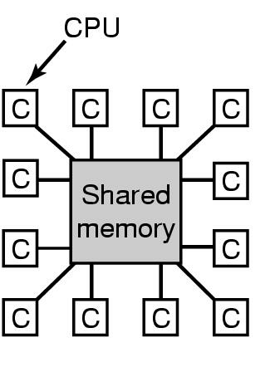
Types of MUOS – Multiprocessor (parallel)
two or more Central Processing Units (CPUs) share the same resources and service the same work
multi-processing systems do not yield a linear speedup due to an increase in communication between the CPUs and the processes running on these processors
tightly coupled/ Symmetric Multi-Processor (SMP)/ Parallel Processing System
share memory and a clock
e.g. shared memory model

Slide 20
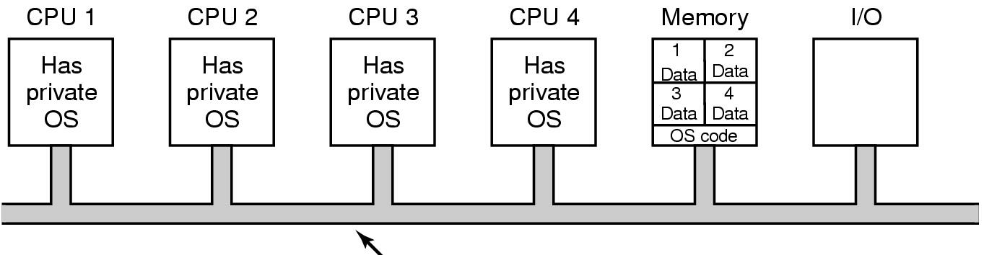
Multiprocessor Systems
Each CPU Has Its Own Operating System
The memory is divided into as many partition as there are CPUs and gives each CPU its own private memory and its own private copy of Operating System

Slide 21
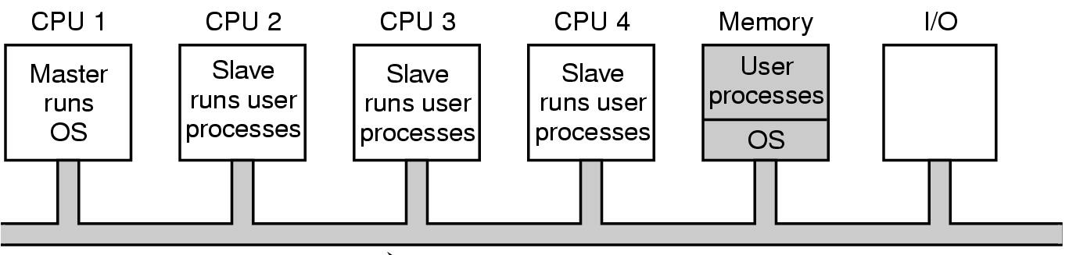
Multiprocessor Systems
Master-Slave Multiprocessors
There is one copy of the operating system present in CPU1.
All system calls are redirected to CPU1
A master processor controls the system

Slide 22
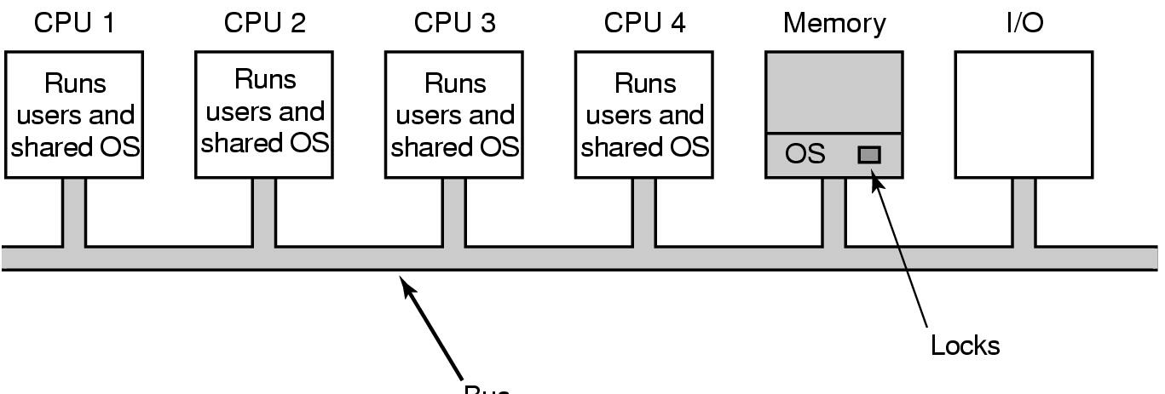
Multiprocessor Systems
Symmetric Multiprocessors (SMP)
There is one copy of the OS in memory but any CPU can run it.
If the two CPU simultaneously picking the same process to run the same memory page. MUTEX(Lock) with OS.

Slide 23
Activity - Multiprocessor
Try and find at least two vendor operating systems that will support multiple processors and the number of processors that each can support e.g.
Name of operating system: Windows 2000 Professional
Maximum number of processors supported: Up to two processors.

Slide 24

Types of MUOS – Time Sliced
Time-slicing - processor will switch from one process to another on a timed basis.
Time-slice/quantum - the amount of CPU time allocated to a process
How does the processor allocate time?
Various scheduling algorithms
e.g. Round Robin Scheduling
What is a process?
A process is similar to a program with the exception that is only interested in completing a single task.
Each program is made up of a number of smaller tasks(processes) that must be completed in order

Slide 25

Types of MUOS – Time-Sliced
Scheduling algorithm - Round Robin Scheduling
Each process is assigned a time slice (quantum)
Each process is allowed to run for however long the quantum is
If the process is still running at the end of its current quantum, the process is interrupted, and the CPU is assigned to another process
If the process has blocked or finished before the quantum has elapsed, the CPU switching is carried out early
scheduler has to maintain a list of runnable processes. When the quantum runs out on a process, its state is saved and it is placed at the end of the list
LENGTH OF QUANTUM IS CRITICAL
Notes:
If time quantum is too large, the response time of the processes is too much which may not be tolerated in interactive environment.
If time quantum is too small, it causes unnecessarily frequent context switch leading to more overheads resulting in less throughput.
Switching from one process to another takes a certain amount of time for loading and saving registers, memory maps and various tables and lists that combine to define a

Slide 26
Activity – Time-sliced
Investigate another type of scheduling other than 'round robin scheduling'.

Slide 27
Types of MUOS – Distributed Systems
Distributed Processing is a technique of distributing the tasks over a number of devices, taking advantage of the large pool of resources
A distributed system is a set of computers interconnected using a communications network
the systems do not share memory or a clock and are often called loosely coupled
distributed systems are heterogeneous i.e. the processors may vary in size and function
A distributed system is managed by a distributed operating system which manages:
the system shared resources
the process scheduling activity (how processes are allocated on available processors)
the communication and synchronization between running processes and so on.
The users of a true distributed system should not know, on which machine their programs are running and where their files are stored

Slide 28
Distributed Systems – Benefits
Resource sharing. A number of different sites (or nodes) with differing resources (both hardware and software) can be connected to one another to provide each other with access to resources that may either be sparse or unavailable at that site. A simple example would be access to a plotter or colour printer at another site.

Slide 29
Distributed Systems – Benefits
Computation speedup.
If processes can be subdivided into tasks that can be carried out either in parallel or even pipelined more effectively then a significant degree of computational speedup can be achieved.
Nodes can effectively work on separate computational tasks and pool the resulting computations to form the final result.
In addition to computational speedup, if a site is overloaded with work it may be possible for it to farm some of the work out to less loaded sites. This farming out of work is known as load sharing.

Slide 30
Distributed Systems – Benefits
Reliability
In a distributed system, a degree of fault tolerance may be possible. Fault tolerance means, if one site fails, the other sites can potentially keep working.
If the system consists of a relatively large number of independent nodes, failure of any one node should not affect the remaining nodes. However, should any one node have a mission critical job and that node should fail, the entire system will fail.
Generally, enough redundancy exists both in hardware and software to ensure that distributed systems have some degree of fault tolerance.

Slide 31
Distributed Systems – Benefits
Communication
A distributed system offers users the ability to share data in a number of ways.
Users may make data available through file transfers
There may be shared file areas for certain users and groups of users to use.

Slide 32

This course will focus on
Linux MUOS

Slide 33
History of Linux
In 1983 Richard Stallman began a movement called the GNU project
“software should be free from restrictions against copying or modification in order to make better more efficient programs”
In 1991 many of the GNU s/w tools were incorporated into a Unix compatible OS by Linus Torvalds (LINUs- uniX)
Linux grew in popularity as a text-based OS, while Windows dominated as a graphical desktop OS.
Linux camp then developed it’s own graphical user interfaces called the K desktop environment and the Gnome environment.
There are multiple Linux GUI environments available today – Unity (default for Ubuntu), Gnome 3, KDE, Xfce, Cinnamon, MATE, LXDE, Xmonad

Slide 34
Introducing Linux
Released under GNU General Public License that ensures it remains free to all users
Access to source code of Linux is unrestricted and may be changed
Linux is truly multi-user, multi-tasking allowing multiple users to simultaneously work with multiple apps. without experiencing any traffic problems
Many web server’s run Linux for this reason
Linux is extremely stable – up-time of more than a year
Lots of free applications comparable to commercial apps.
e.g. LibreOffice and WPS Office similar to MS Office suite, GIMP provides similar features to Photoshop

Slide 35
Choosing a Linux Distribution
Linux MUOS
Kernel
System level programs
User level programs
Linux Distributions
Debian
Elementary OS
Linux Mint
Arch Linux
Ubuntu
CentOS 7 (off shoot from RedHat)
openSUSE
Linux Distribution
TUX
“(T)orvald’s (U)ni(X)”

